Slide 1
Algorithms: Greedy Method
An Activity-Selection Problem

Slide 2
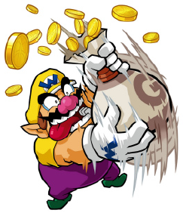
Greedy Algorithms: Principles
A greedy algorithm always makes the choice that looks best at the moment.
A greedy algorithm works in phases.
At each phase:
You take the best you can get right now, without regard for future consequences.
You hope that by choosing a local optimum at each step, you will end up at a global optimum.
For some problems, it works.

Slide 3
Being a very busy person, you have exactly T time to do some interesting things and you want to do maximum such things. You are given an array A of integers, where each element indicates the time a thing takes for completion. You want to calculate the maximum number of things that you can do in the limited time that you have.
https://www.hackerearth.com/practice/algorithms/greedy/basics-of-greedy-algorithms/tutorial/

Slide 4
An Activity Selection Problem
Input: A set of activities S = {a₁,…, a_{n}}
Each activity a_{i} has a start time s_{i} and a finish time f_{i}, where 0 ≤ s_{i} < f_{i} < ∞
If selected, activity a_{i} takes place during the half-open time interval [s_{i}, f_{i})
Two activities are compatible if and only if their intervals do not overlap
Output: a maximum-size subset of mutually compatible activities

Slide 5
The Activity Selection Problem
Here are a set of start and finish times
i 1 2 3 4 5 6 7 8 9 10 11
s_{i} 1 3 0 5 3 5 6 8 8 2 12
f_{i} 4 5 6 7 8 9 10 11 12 13 14
What is the maximum number of activities that can be completed?
{a₃, a₉, a₁₁} can be completed
But so can {a₁, a₄, a_{8,} a₁₁} which is a larger set
But it is not unique, consider {a₂, a₄, a₉ , a₁₁}

Slide 6
The Activity Selection Problem
Here are a set of start and finish times
i 1 2 3 4 5 6 7 8 9 10 11
s_{i} 1 3 0 5 3 5 6 8 8 2 12
f_{i} 4 5 6 7 8 9 10 11 12 13 14
What is the maximum number of activities that can be completed?
{a₃, a₉, a₁₁} can be completed
But so can {a₁, a₄, a_{8,} a₁₁} which is a larger set
But it is not unique, consider {a₂, a₄, a₉ , a₁₁}

Slide 7
Interval Representation
Here are a set of start and finish times
i 1 2 3 4 5 6 7 8 9 10 11
s_{i} 1 3 0 5 3 5 6 8 8 2 12
f_{i} 4 5 6 7 8 9 10 11 12 13 14

Slide 8
0 1 2 3 4 5 6 7 8 9 10 11 12 13 14 15

Slide 9
compatible tasks
0 1 2 3 4 5 6 7 8 9 10 11 12 13 14 15

Slide 10
earliest finish time
0 1 2 3 4 5 6 7 8 9 10 11 12 13 14 15

Slide 11
an alternative correct solution
0 1 2 3 4 5 6 7 8 9 10 11 12 13 14 15

Slide 12
Early Finish Greedy
Select the activity with the earliest finish
Eliminate the activities that could not be scheduled
Repeat!

Slide 13
0 1 2 3 4 5 6 7 8 9 10 11 12 13 14 15

Slide 14
0 1 2 3 4 5 6 7 8 9 10 11 12 13 14 15

Slide 15
0 1 2 3 4 5 6 7 8 9 10 11 12 13 14 15

Slide 16
0 1 2 3 4 5 6 7 8 9 10 11 12 13 14 15

Slide 17
0 1 2 3 4 5 6 7 8 9 10 11 12 13 14 15

Slide 18
0 1 2 3 4 5 6 7 8 9 10 11 12 13 14 15

Slide 19
0 1 2 3 4 5 6 7 8 9 10 11 12 13 14 15

Slide 20
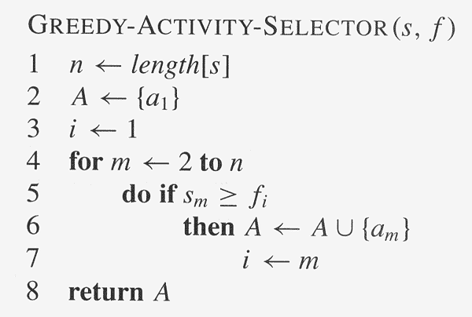
Assuming activities are sorted by finish time

